Slide 1
Classes & SYSTEMS
Clean code – Robert C. Martin

Slide 2
classes

Slide 3
Class Organization
Highlight:
A class should begin with a list of variables in below order:
public static constants
private static variables
private instance variables
Summary:
Encapsulation – Keep variables & util functions private but not always, sometime keep them protected for testing purpose.

Slide 4
Small Classes
Highlight: The ﬁrst rule of classes is that they should be small
Summary: Method count is not the correct way to measure the size of a class because small number of method count in a class can have too many responsibilities, we can measure the size of class using responsibilities count
Single Responsibility Principle - The Single Responsibility Principle (SRP) states that a class or module should have one, and only one, reason to change. This principle gives us both a deﬁnition of responsibility, and a guidelines for class size. Classes should have one responsibility—one reason to change.
Cohesion - Classes should have a small number of instance variables. Cohesion is the Object Oriented principle most closely associated with making sure that a class is designed with a single, well-focused purpose.

Slide 5
Organizing for Change

Slide 6
Organizing for Change
Highlight: A class must be opened for changes
Summary: A Class must be structured in such a way that when we add new features then code changes should be little as possible. In an ideal system, we incorporate new features by extending the class, not by making modiﬁcations to existing code. The class must support Open-Closed Principle.
Open/Closed Principle: This object oriented design first described by Bertrand Meyer that says that “software entities (classes, modules, functions, etc.) should be open for extension, but closed for modification”.
Isolating from change - The interfaces or base classes are the ones being both open and closed – they’re open to be derived from and closed for modifying their content.

Slide 7
SYSTEMs

Slide 8

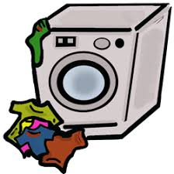

System
A system, built by group of individual, for other group of individual that will make their work faster, efficient and effortless.
I’ll make a machine that washes cloths
I want to wash my cloths

Slide 9
Building System
Systems are complex, as they serve’s different responsibilities and being development by different set of peoples.
  Creating different Parts of system
  Integrating these parts to coordinate together
  Protecting parts & other resources
  Monitoring & troubleshooting
  Serving the final outcome

Slide 10
Separate Constructing a System from Using It

Slide 11
Separate Constructing a System from Using It
Software systems should separate the startup process, when the application objects are constructed and the dependencies are “wired” together, from the runtime logic that takes over after start-up.
The separation of concerns is one of the oldest and most important design techniques in our craft.
  We often forget this term. (Demo)

Slide 12
Single responsibility principle
public Service getService() {
if (service == null)
service = new MyServiceImpl(...);
// Good enough default for most cases?
return service;
}
LAZY INITIALIZATION/EVALUATION
hard-coded dependency
Start-up can be faster
Testing can be a problem
Ensure null check
Mixed construction with runtime processing

Slide 13
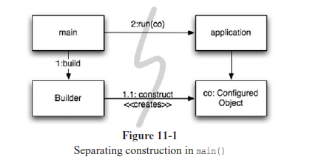
Separation of main
Move all aspects of construction to main, or modules called by main.
Now Design system assuming objects have been constructed.

Slide 14
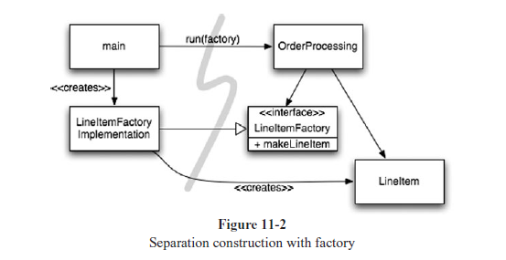
Factories
The application should control when to build the object
Keep the details of that construction separate from the application code.

Slide 15
Dependency injection
Delegate responsibility of object construction to other object
Managing dependency using property setter or construction
Declarative approach extends object configuration to next level by separating it from uses. (e.g.: Spring Framework)
Notes:
Dependency Injection (DI),
the application of Inversion of Control (IoC) to dependency management.3 Inversion of
Control moves secondary responsibilities from an object to other objects that are dedicated
to the purpose, thereby supporting the Single Responsibility Principle. In the context of
dependency management, an object should not take responsibility for instantiating dependencies
itself. Instead, it should pass this responsibility to another “authoritative” mechanism,
thereby inverting the control. Because setup is a global concern, this authoritative
mechanism will usually be either the “main” routine or a special-purpose container.

Slide 16
Scaling up

Slide 17
Software systems are unique compared to physical systems. Their architectures can grow incrementally, if we maintain the proper separation of concerns.

Slide 18
Scale-up
Cross cutting concerns separation
Java Proxies: use of byte-code manipulation library, such as CGLIB,ASM and javassist.
  Lot of extra code and relatively complex
  Scattered around when in need.
Pure Java AOP: Java frameworks that implements proxies internally. Its serves almost 80-90 % of CCC need.
  Less code and easy to implement
  Boilerplate code handled automatically by separation & weaving
AspectJ: Most matured and rich framework for CCC.
  AspectJ needs you to adopt several new tools and to learn new language constructs.

Slide 19
Test driven system architecture
Write test-case to architecture testing
System testing is a great key in building scalable and futuristic systems
Early resolution to non-functional problems helps stable and faster developed system
  Infrastructural Issue
  Technology integration
  Stretch out issue

Slide 20
Optimize decision making

Slide 21
Agile Decision
The agility provided by a POJO system with modularized concerns allows us to make optimal, just-in-time decisions, based on the most recent knowledge. The complexity of these decisions is also reduced.
Decentralized management
Multiple persons with adequate knowledge can take decision
Postpone decision until the last possible moment

Slide 22
Use of standards

Slide 23
Use Standards Wisely
Standards
  Specialized, effective and flexible developed by people with rich experiences
  They make it easier to reuse idea and components
  Widely accepted & supported
Skip standards
  Standards take long creation time, its not feasible to wait for that time.
  Some standards lose touch with real needs of the adopters they are intended to serve. (E.g. EJB)
“use standards only when they add demonstrable value”

Slide 24
Domain specific languages
Domain-Specific Languages allow all levels of abstraction and all domains in the application
to be expressed as POJOs, from high-level policy to low-level details.

Slide 25
System need domain specific languages
Build system that is driven by business
Systems are less prone of error due to communication gap
CSS is the best example of it.

Slide 26
THAT’S ALL FOLKS!!
- Mohit & Balkrishan
Write to: Balkrishan.Chauhan@irissoftware.com
Mohit.Tyagi@irissoftware.com

